Slide 1
Applications of Evolutionary Protein Bioinformatics in Basic and Biomedical Research
Ogun Adebali
March 2016
Notes:
Introduce myself

Slide 2
"Nothing in biology makes sense except in the light of evolution“
Theodosius Dobzhansky
"DNA is like a computer program but far, far more advanced than any software ever created.“
Bill Gates
Notes:
“DNA is like a computer program but far, far more advanced than any software ever created.”
Bill Gates

Slide 3
Central Dogma of Biology
DNA RNA Protein

Slide 4
A protein
?
?
?
What is its function?
Who are its partners?
What is the importance of each amino acid?

Slide 5
Outline
Introduction
Part I: What is the function?
Part II: Who are the partners?
Part III: What is the importance of each amino acid?
Conclusion

Slide 6
PART I
Adebali, O., Ortega, D. R., & Zhulin, I. B. (2015)
CDvist: a webserver for identification and visualization of conserved domains in protein sequences
Bioinformatics, 31(9), 1475-1477.

Slide 7
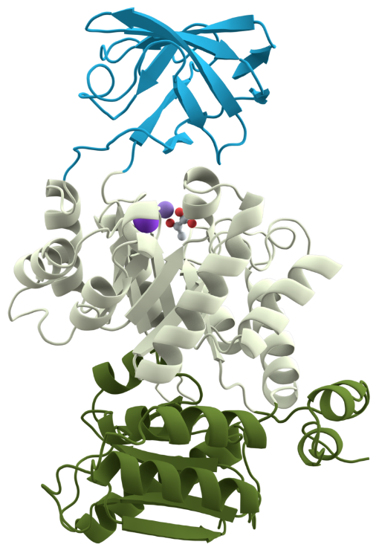
Protein domain
Minimal functional unit of a protein that can evolve and fold independently.
Proteins are composed of one or more domains.
Evolutionary events:
Fusion
Disassociation
Shuffling
Duplication
Deletion
Notes:
Domains have limits on size.^{[25]} The size of individual structural domains varies from 36 residues in E-selectin to 692 residues in lipoxygenase-1,^{[16]} but the majority, 90%, have less than 200 residues^{[26]} with an average of approximately 100 residues.^{[27]} Very short domains, less than 40 residues, are often stabilised by metal ions or disulfide bonds. Larger domains, greater than 300 residues, are likely to consist of multiple hydrophobic cores.^{[28]}
The majority of genomic proteins, two-thirds in unicellular organisms and more than 80% in metazoa, are multidomain proteins created as a result of gene duplication events.^{[35]} Many domains in multidomain structures could have once existed as independent proteins. More and more domains in eukaryotic multidomain proteins can be found as independent proteins in prokaryotes.^{[36]} For example, vertebrates have a multi-enzyme polypeptide containing the GAR synthetase, AIR synthetase and GAR transformylase modules (GARs-AIRs-GARt; GAR: glycinamide ribonucleotide synthetase/transferase; AIR: aminoimidazole ribonucleotide synthetase). In insects, the polypeptide appears as GARs-(AIRs)2-GARt, in yeast GARs-AIRs is encoded separately from GARt, and in bacteria each domain is encoded separately.^{[37]}
http://cdvist.utk.edu/codost_out/20150116084741976125.html

Slide 8
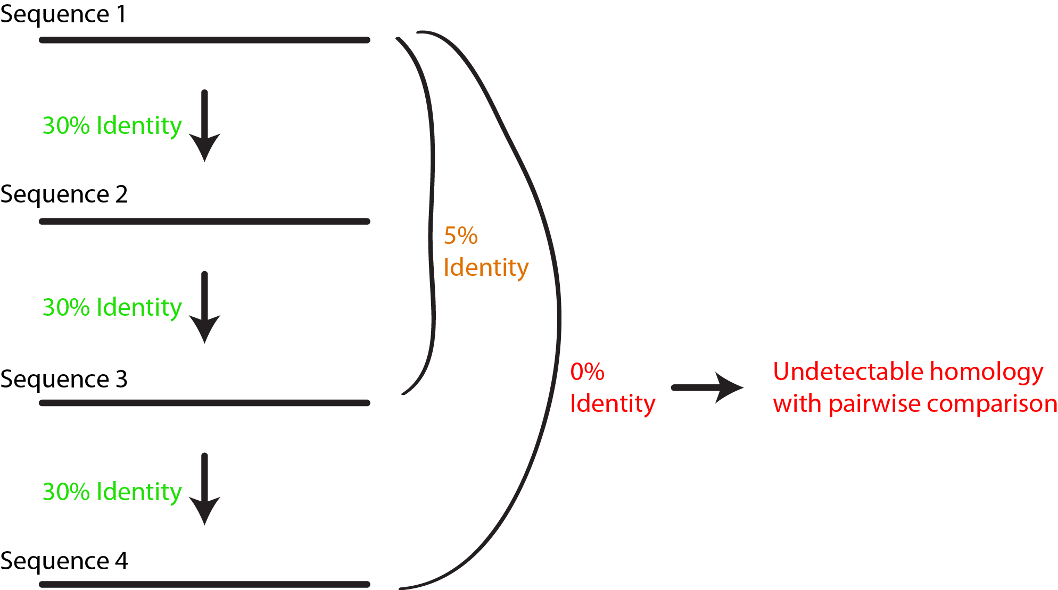
Approaches in sequence based domain prediction
Pairwise sequence comparison.
Model based prediction
Hidden Markov Models (HMMs) → HMMER
Position Specific Score Matrices (PSSMs) → RPSBLAST
Model – Model comparison
HMM – HMM search → HHsearch

Slide 9
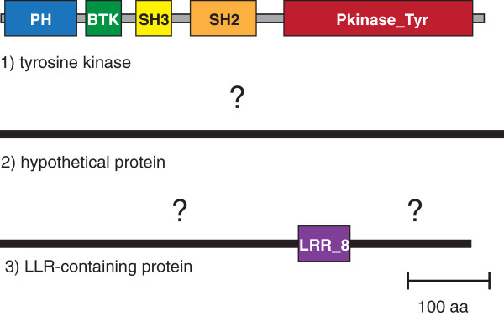
Domain Coverage
Error in sequence
Non globular sequences
The domain is novel.
We cannot detect the domain.
Rekapalli et al. 2012
Notes:
Three representative proteins from the human genome are shown: (1) a tyrosine kinase (GI: 307508) has a comprehensive coverage by five Pfam domains (shown as colored rectangles with their respective names). Sequence regions that are less than 50 aa long are shown as grey lines; (2) a hypothetical protein (GI: 341913853) has no matches to any known protein domain or region and is considered part of “dark matter” (shown as a black line with a question mark above); (3) a leucine-rich repeat-containing protein is characterized only partly by a match to the LLR_8 (leucine-rich repeat) domain; however two large portions of its sequence (90% of total amino acid residues) show no matches to any domain or region, and therefore should be considered a part of “dark matter” (black lines with question marks above).

Slide 10
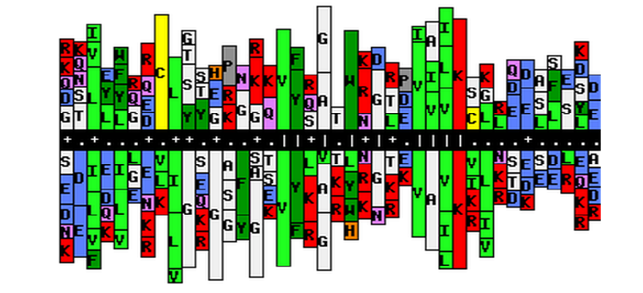
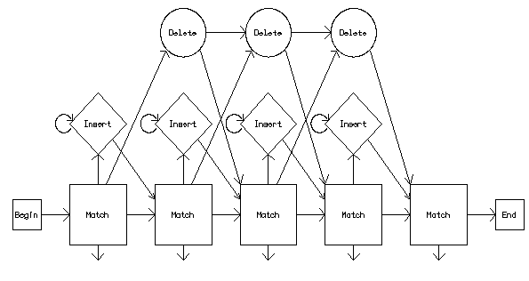
HMM-HMM search
Profile
Search similar sequences
sequence DB
profile DB
Search new sequences
similar matching with the profile
Alignment
Domain assignment
Profile

Slide 11
The problems
HMMER and RPSBLAST is specific
HHsearch is sensitive
Produces false positives
There is a need for model generation before searching.

Slide 12
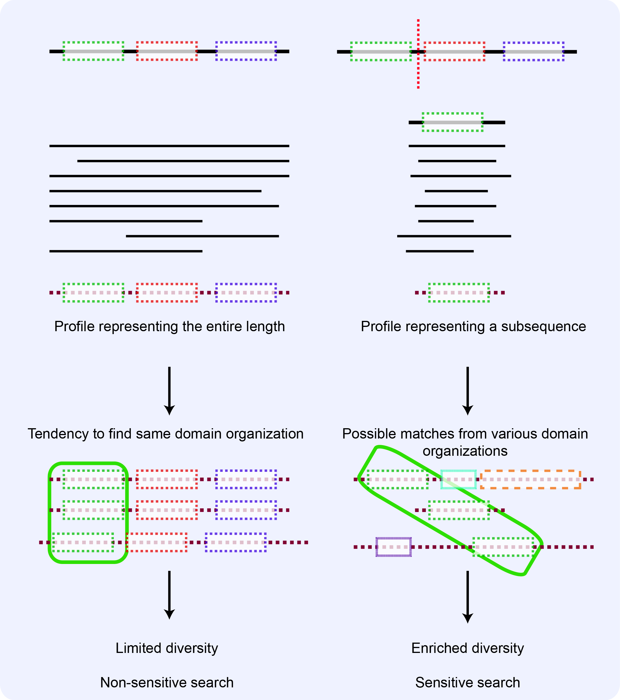

Slide 13
The problems -2
There is no server performing HHsearch on batch requests.
Current domain architecture visualization needs an improvement.

Slide 14
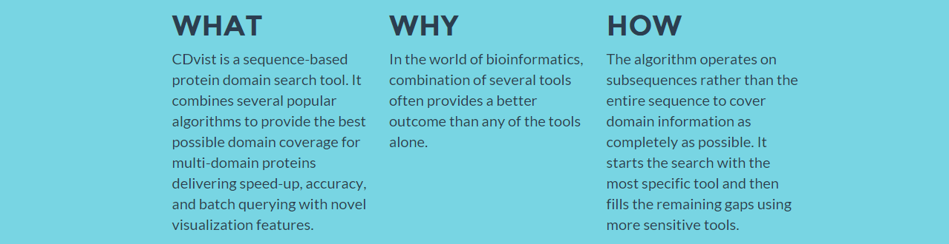
CDvist

Slide 15
HMMER3
RPSBLAST on CDD
HHsearch on Pfam
HHsearch on PDB

Slide 16
Conclusions
Novel domain search pipeline
Pipeline is customizable
Linear speed-up for batch requests
Novel visualization features
Biologist-friendly
Parsable results for bioinformaticians

Slide 17
PART II
Adebali, O. & Zhulin, I. B. (2016)
Aquerium: a web-based platform for visualizing and comparing phylogenetic profiles

Slide 18
Phylogenetic profiling
Presence of absence of proteins in genomes.
IDEA: Similar occurrence patterns indicate functionally interacting proteins.

Slide 19
Problems
No visualization platform for ABSENCE.
No tool for domain-based profiling.
No multi-query visualization platform.
No comprehensive domain architecture querying.

Slide 20
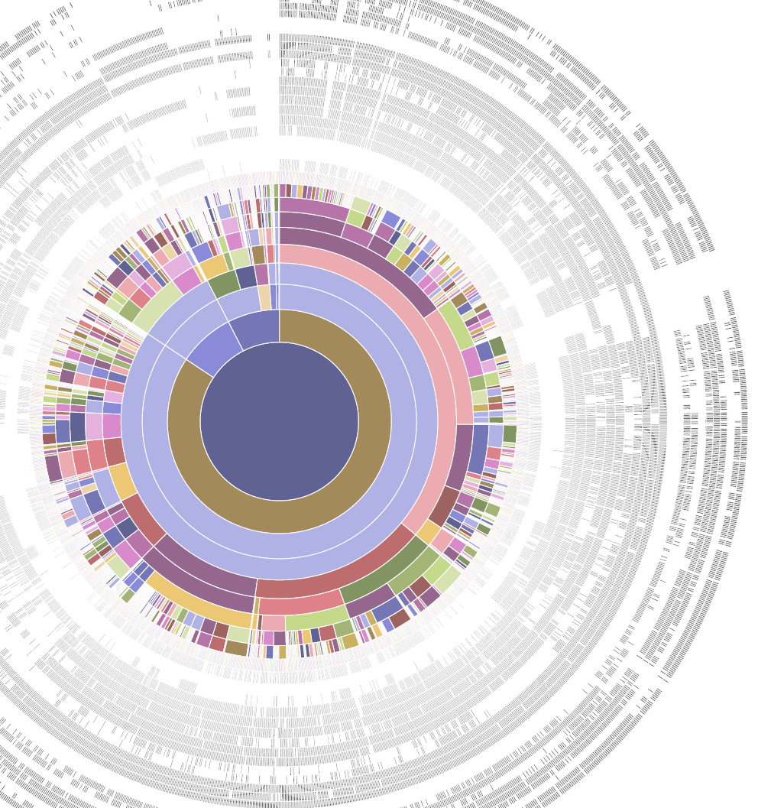
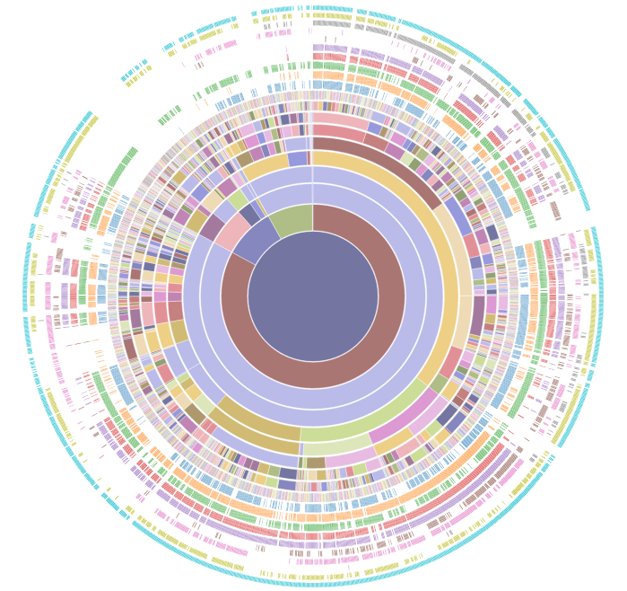
Aquerium
Architecture querying podium

Slide 21
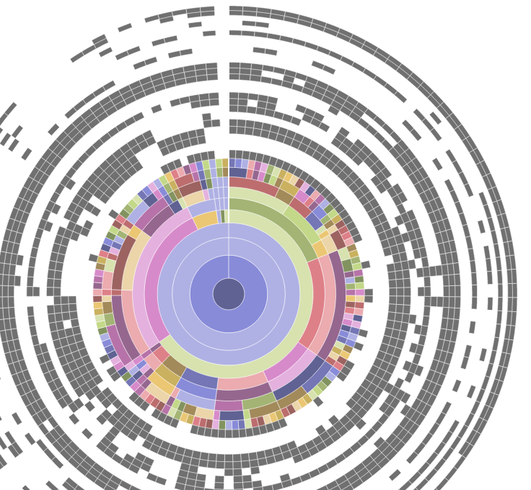
What is Aquerium?
A web application that
clusters species by their taxonomic lineages
represents the tree on a circular layout
maps desired binary/numerical input on outer orbits

Slide 22

Domain Querying
PFAM 27.0 and 28.0
TIGRFAM 14 and 15
Advanced querying

Slide 23
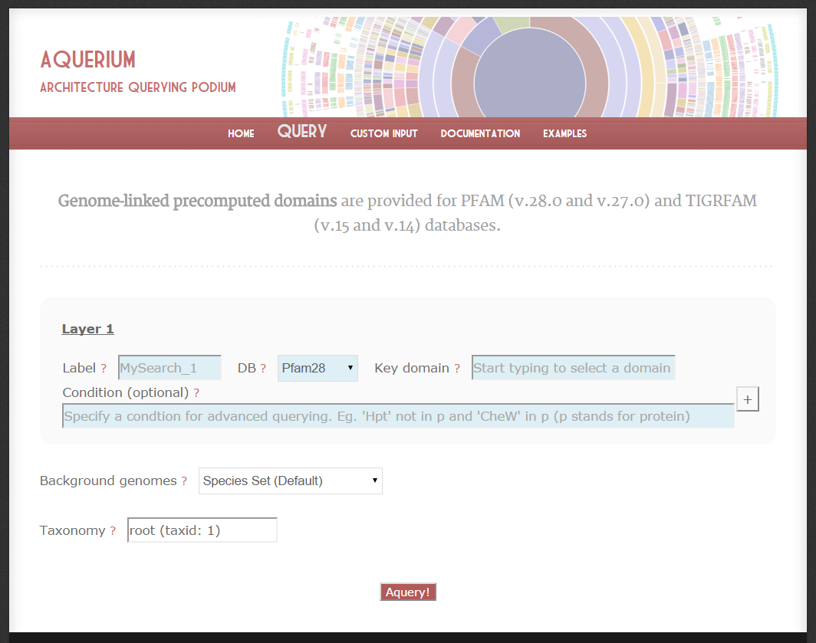

Slide 24
'Aldedh' in p and 'AA_kinase' in p ## If both 'Aldedh' and 'AA_kinase' domains are in in protein addition to the key domain. 'Aldedh' not in p and 'AA_kinase' in p ## Protein cannot have 'Aldedh' and must have 'AA_kinase' domain in addition to the key domain. 'Aldedh' in p or 'AA_kinase' in p ## Either 'Aldedh' or 'AA_kinase' must be in protein in addition to the key domain. p.index('AA_kinase')==0 ## 'AA_kinase' domain must be the first domain in protein (from N-terminal to C-terminal). ## Hint: in python, array index starts with 0 (zero) p.index('Aldedh')==1 ## 'Aldedh' must be the second domain (N'-->C' direction) p.index('AA_kinase')==0 and p.index('Aldedh')==1 ## 'AA_kinase' must be the first domain AND 'Aldedh' must be the second domain p.index('AA_kinase') < p.index('Aldedh') ## First 'AA_kinase' in protein must be present before 'Aldedh' ## Note: index function returns -1 for domains which are not present in p. So this function also returns the proteins that have no AA_kinase and at least one Aldedh ## Note2: If you want 'AA_kinase' to be in p, you can always add extra conditions such as: 'AA_kinase' in p and p.index('AA_kinase') < p.index('Aldedh') p.count('CheW')>2 ## Returns proteins containing 3 or more 'CheW' domains. ## Priority can be specified with parenthesis as well: ('CheW' in p and ('Response_reg' in p or 'Hpt' in p))

Slide 25
Human δ-1-pyrroline-5-carboxylate synthetase
E.coli γ-glutamyl phosphate reductase
E.coli glutamate-5-kinase
Marcotte et al Science (1999)

Slide 26
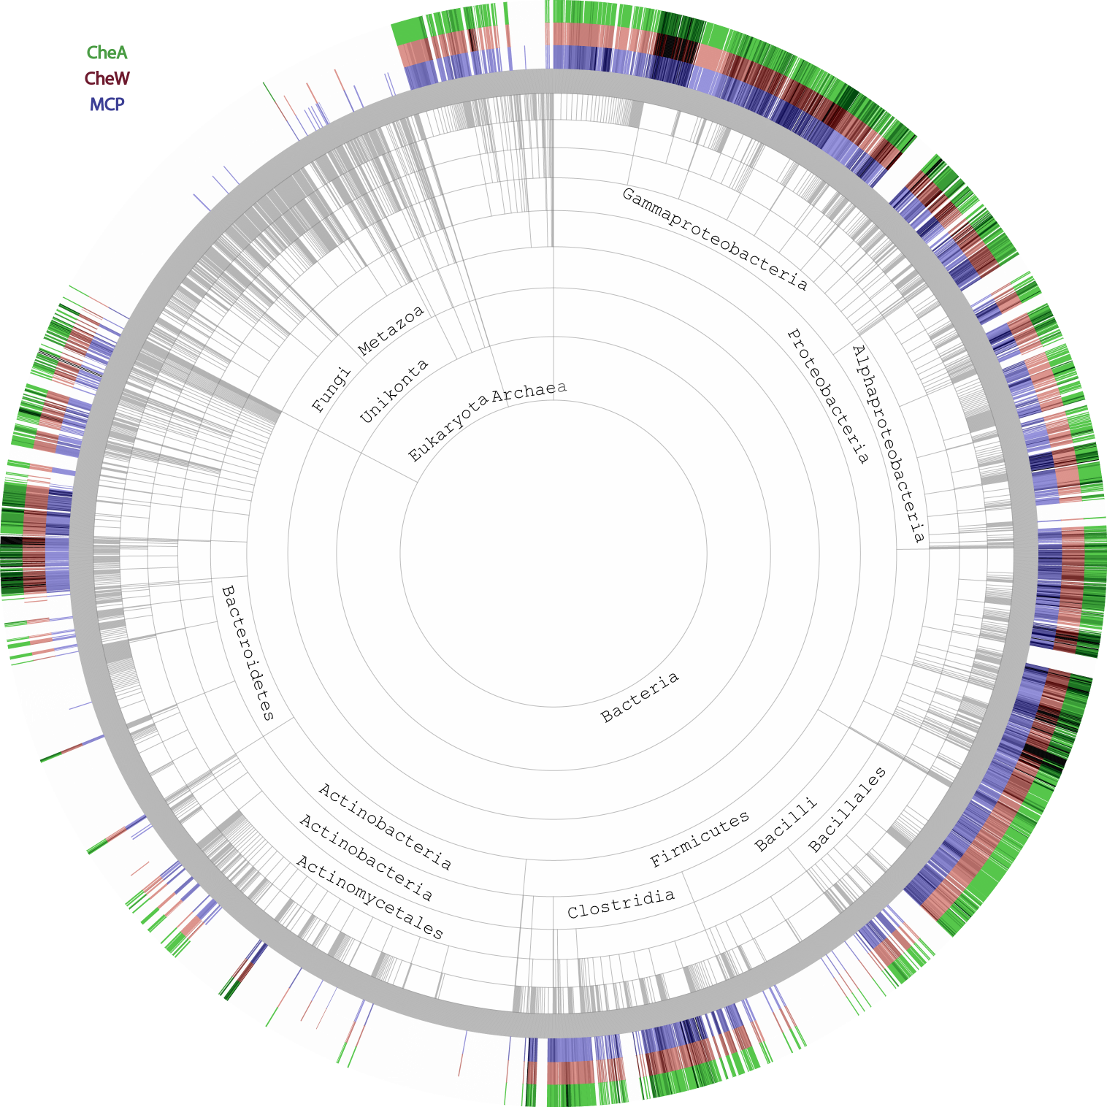

Slide 27
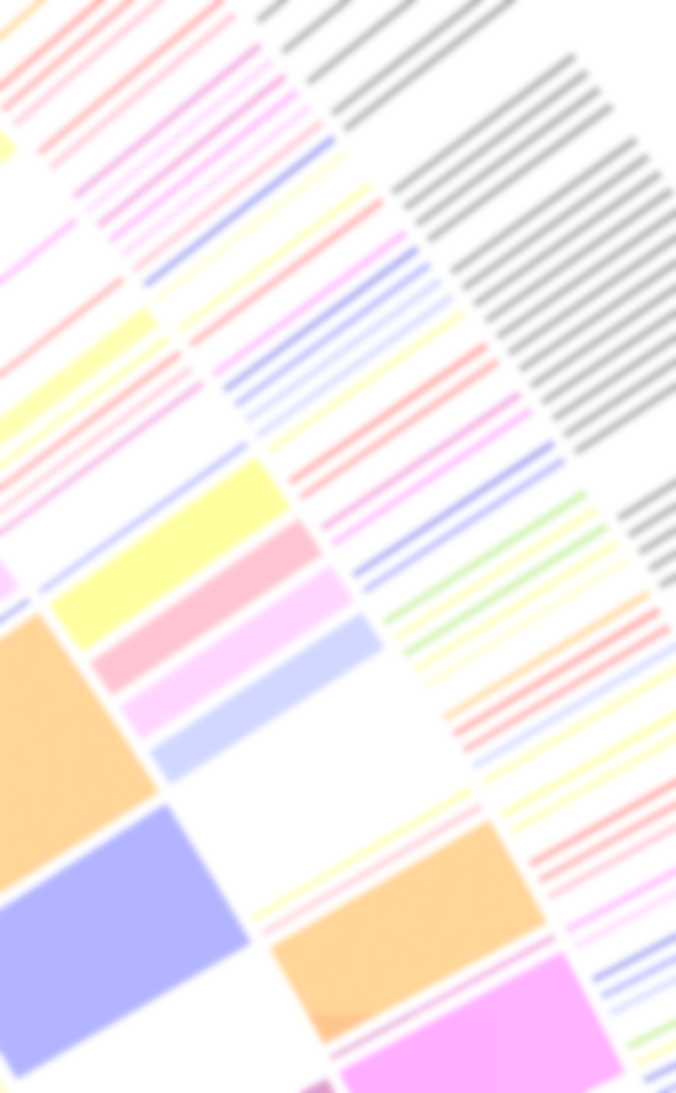
Conclusion
Promising tool for comparative genomics with any kind of biological flag.
Visualizing taxonomic distributions of multiple metagenomes on the same picture is possible.
Domain architecture querying is offered.
Custom input is possible.
GI list can be used as input.
Easy visualizing of blast results is offered.

Slide 28
PART III
Adebali, O. , Reznik A.O., Ory D.S. & Zhulin, I. B. (2016)
Establishing the Precise Evolutionary History of a Gene Improves Prediction of Disease Causing Missense Mutations
Genetics in Medicine

Slide 29

Symptoms
Suspected a Genetic Disease
Verification?

Slide 30
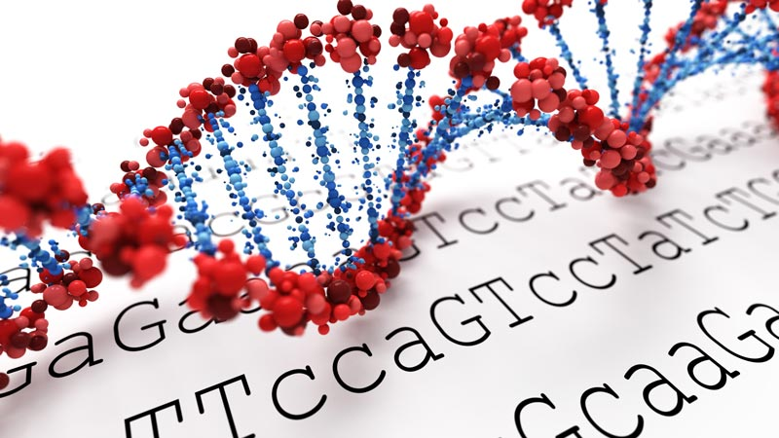
Genetic Testing
Mutation Found
Obvious result
Known Disease-causing
Frequent allele
Novel

Slide 31
Status Quo: deleterious mutations are predicted by automated bioinformatics tools
Name | Reference | Basis
ConSurf | Ashkenazy et al. 2010 | Evolutionary conservation
FATHMM | Shihab et al. 2013 | Evolutionary conservation
MutationAssessor | Reva et al. 2011 | Evolutionary conservation
PANTHER | Thomas and Kejariwal 2004 | Evolutionary conservation
PhD-SNP | Capriotti et al. 2006 | Evolutionary conservation
SIFT | Ng and Henikoff 2003 | Evolutionary conservation
SNAP2 | Hecht et al. 2015 | Evolutionary conservation and predicted structural information
SNPs&GO | Calabrese et al. 2009 | Protein structure/function
Align GVGD | Mathe et al. 2006 | Protein structure/function and evolutionary conservation
MAPP | Stone and Sidow 2005 | Protein structure/function and evolutionary conservation
MutationTaster | Schwarz et al. 2010 | Protein structure/function and evolutionary conservation
MutPred | Li et al. 2009 | Protein structure/function and evolutionary conservation
PolyPhen-2 | Adzhubei et al. 2013 | Protein structure/function and evolutionary conservation
PROVEAN | Choi and Chan 2015 | Alignment and measurement of similarity between variant sequence
nsSNPAnalyzer | Bao et al. 2005 | Multiple sequence alignment and protein structure analysis
Condel | Gonzalez-Perez and Lopez-Bigas 2011 | Combines SIFT, PolyPhen-2, and MutationAssessor
CADD | Kircher et al. 2014 | Contrasts annotations of fixed/nearly fixed derived alleles in humans with simulated variants
Adebali 2015

Slide 32

Black box and others
Input
Mutation
Output
Structural modification
Functional change
Natural selection
Phenotype
Evolution

Slide 33
Inconsistency between tools
LRT
409 (32%)
36
(3%)
172
(13%)
93
(7%)
160 (12%)
62
(5%)
364 (28%)
Chun and Fay 2009
PolyPhen
SIFT

Slide 34
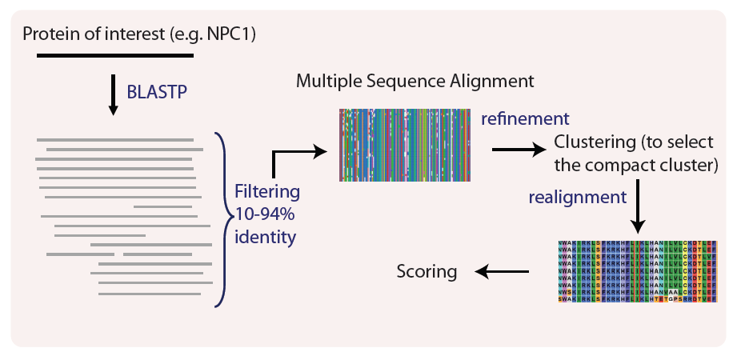
PolyPhen-2 automated pipeline

Slide 35
Gene Duplication
Gene B
Neofunctionalization
Duplication
Gene A
Gene A
Gene A’
Subfunctionalization
Pseudogene
Nonfunctionalization

Slide 36
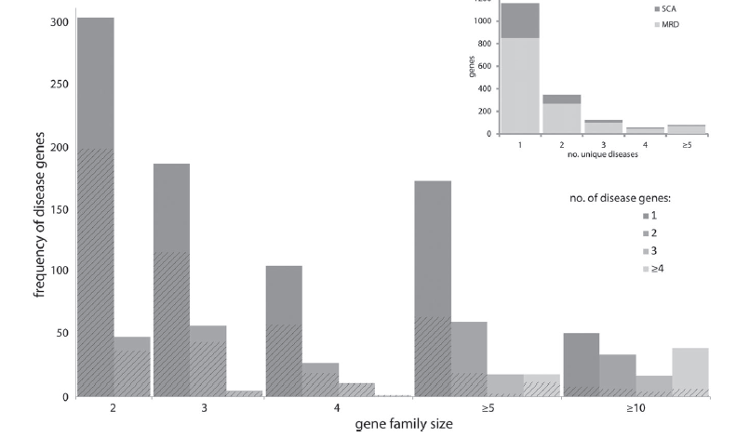
Paralog problem
Dickerson and Robertson (2012)

Slide 37
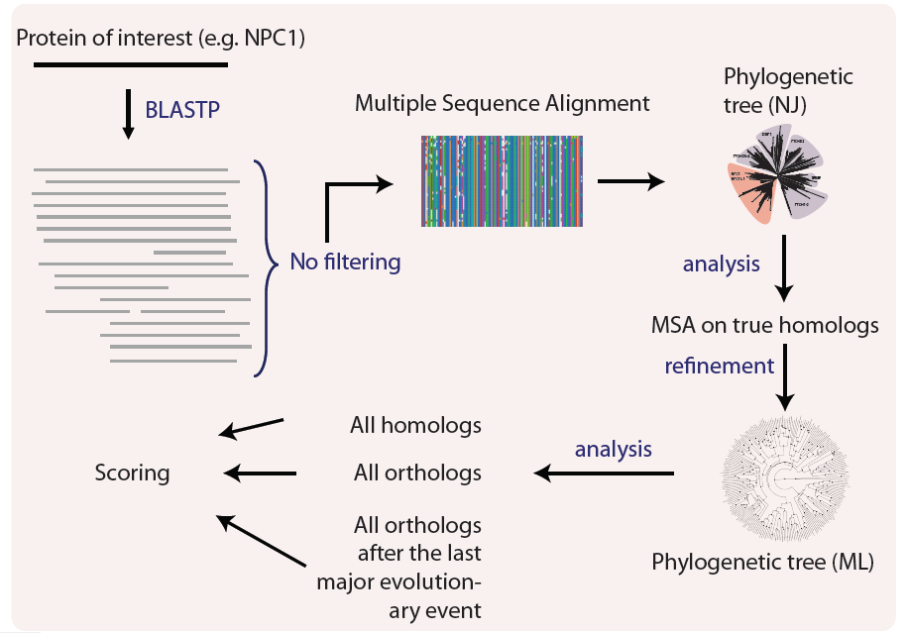
Our
approach

Slide 38
NPC1
A perfect case for our proof-of-concept:
Monogenic disease
Many known disease-causing mutations (for positive control)
Known frequent variants that are likely to be benign

Slide 39
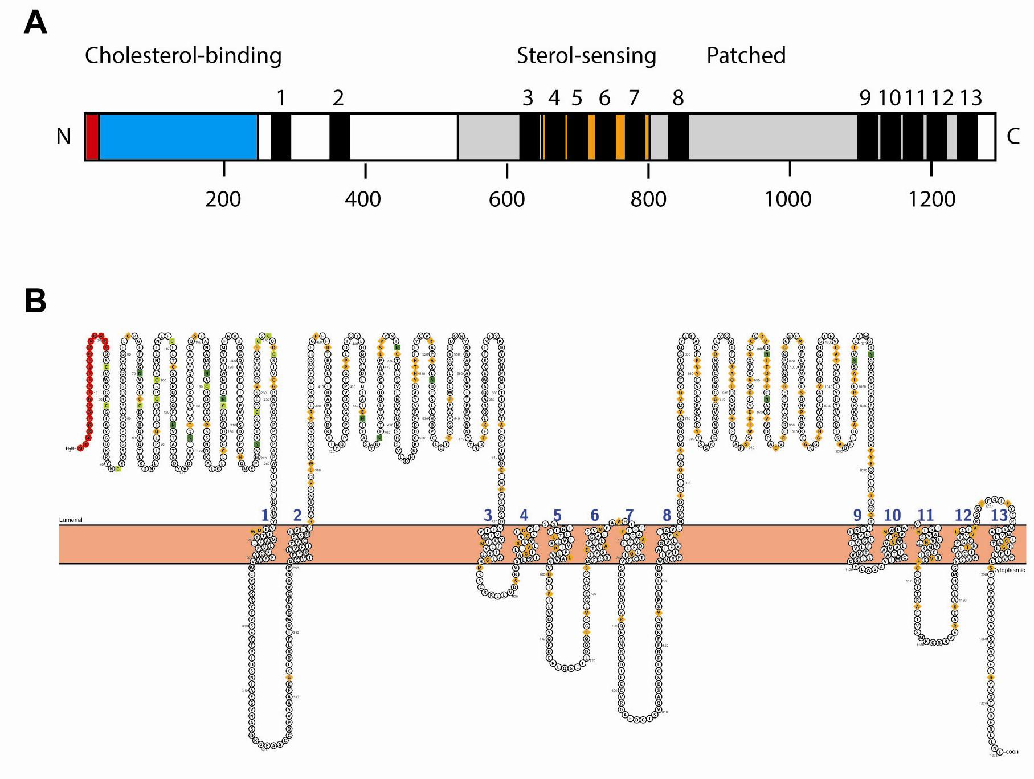
NPC1
Domain architecture
Membrane topology

Slide 40
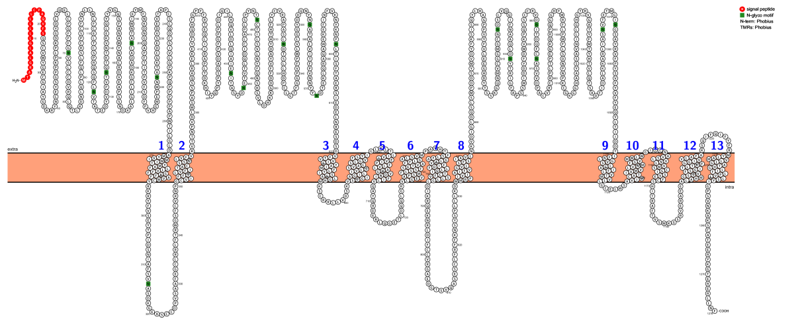
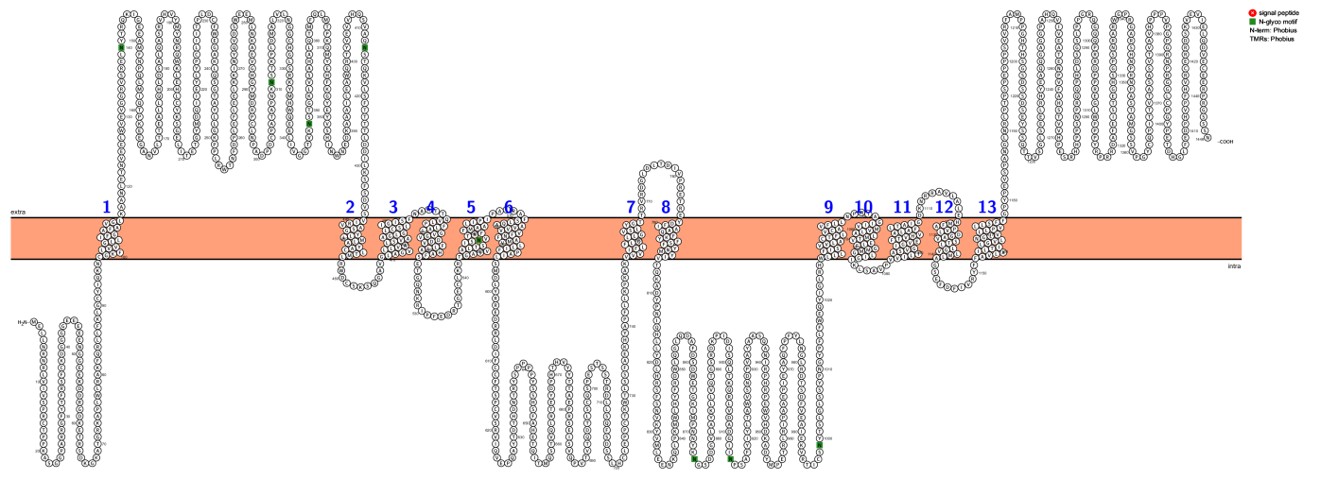
NPC1 is similar to patch proteins
similarity
NPC1
similarity
PTC1

Slide 41
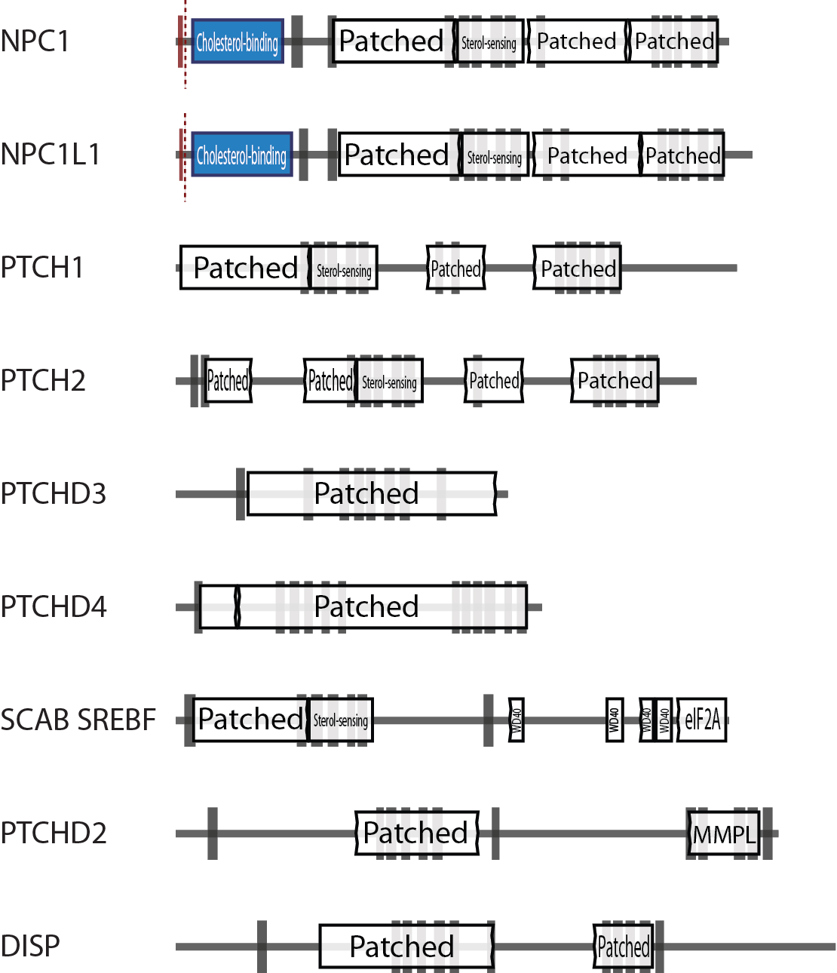
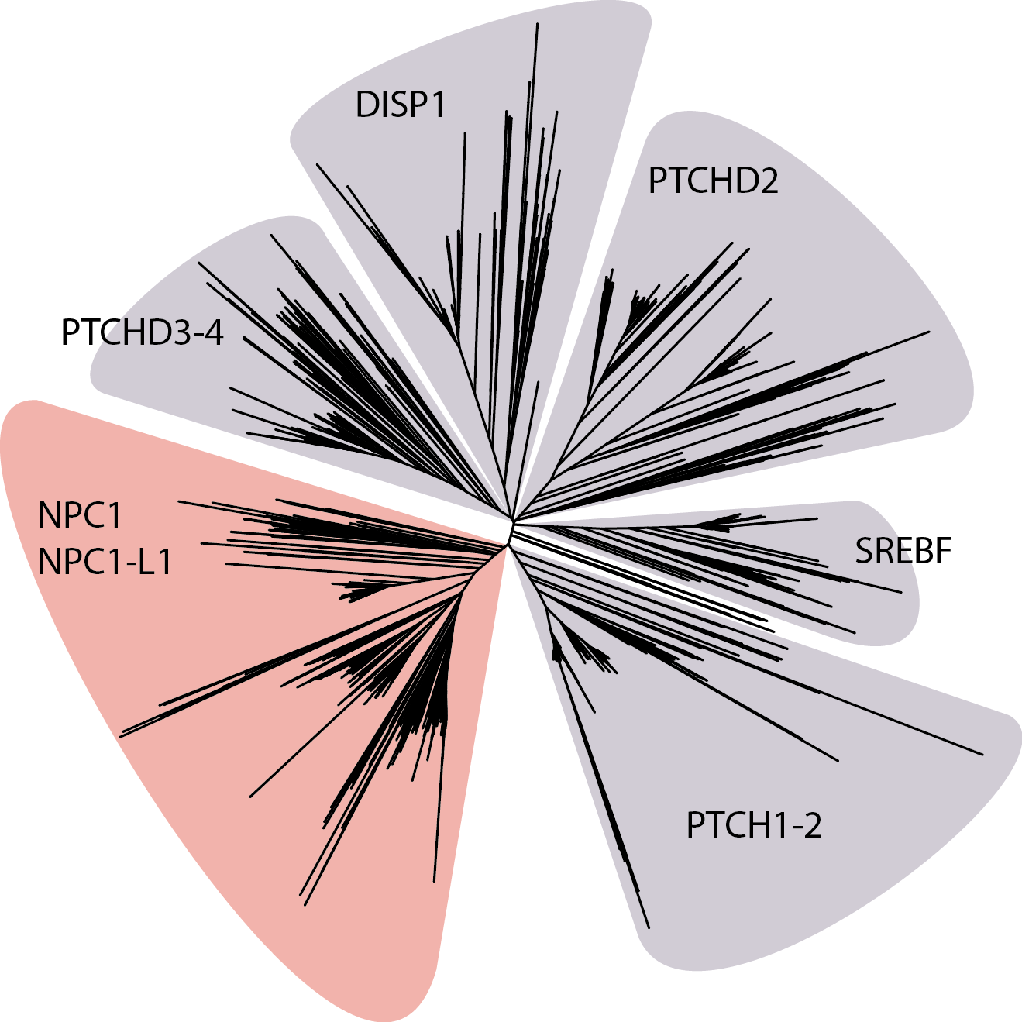
Patch proteins form distinct clusters

Slide 42
1 copy
2 copies
>2 copies

Slide 43
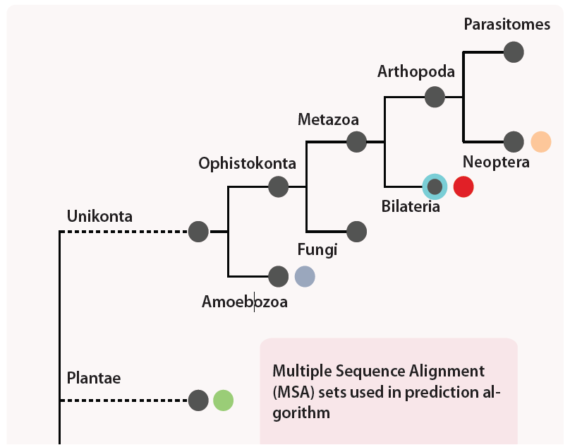
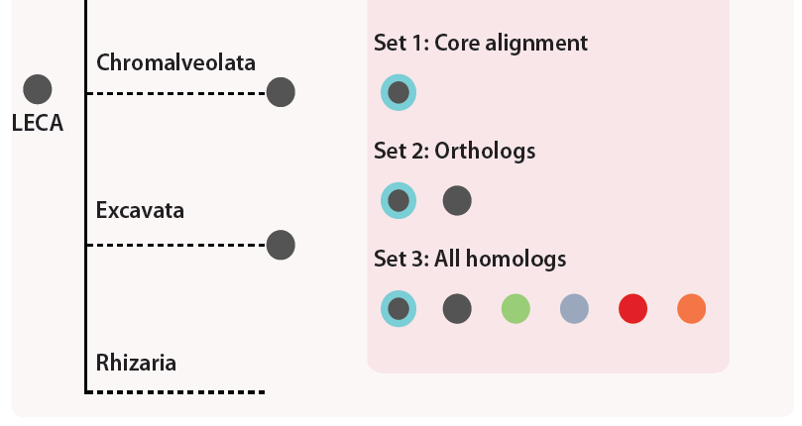
Gnathostomata

Slide 44
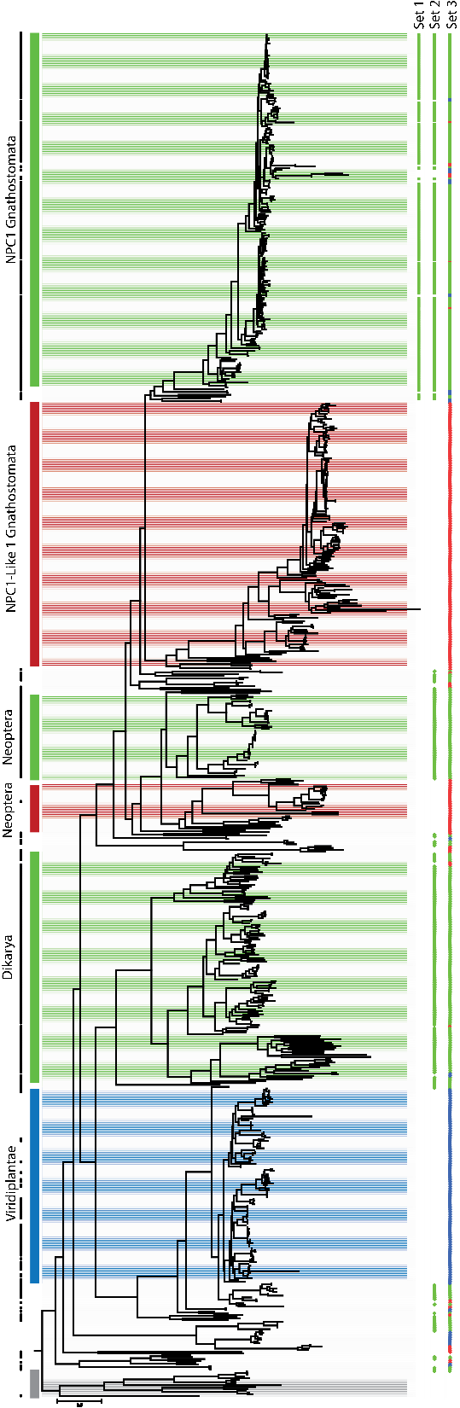

Slide 45

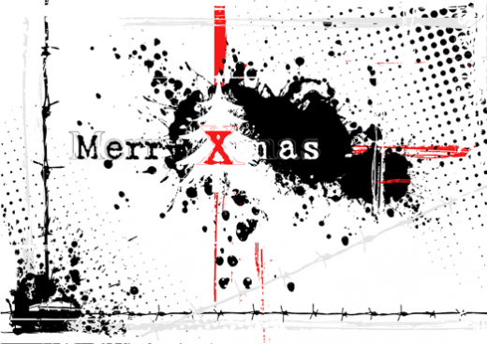
NPC1 &
NPC1L1

Slide 46
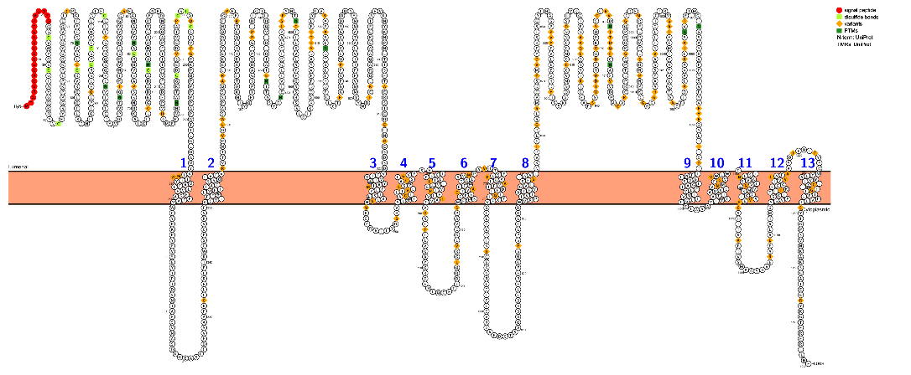
NPC1
NPC1L1
Inactivating mutations cause
Niemann-Pick Disease
Inactivating mutations cause
Reduced risk in coronary heart disease (human)
Protection against colon cancer (mice)

Slide 47
Looking behind the facade

Slide 48
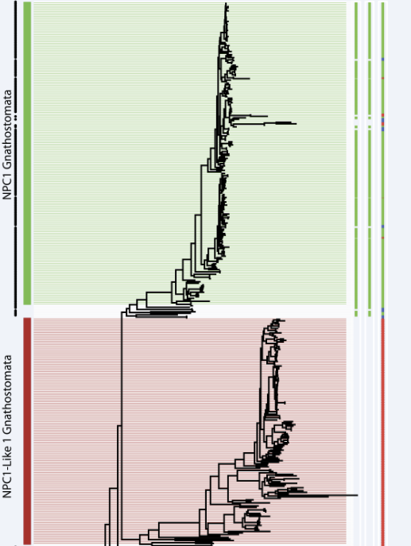

Slide 49
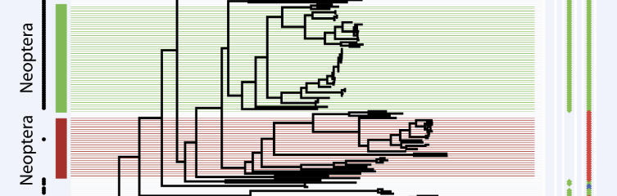

Slide 50
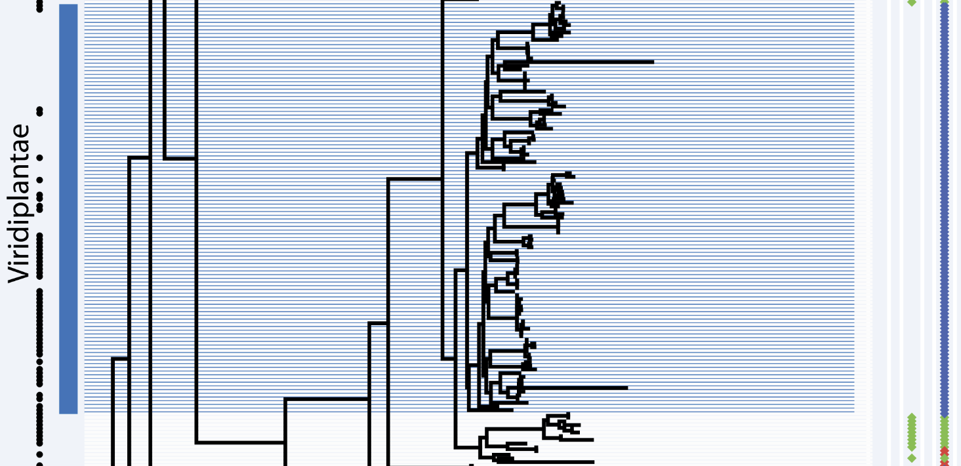

Slide 51
NPC1 phylogenetic tree (ML)
Proteins used in PolyPhen-2 algorithm

Slide 52
3 Sets with different weights
Set 1: NPC1 orthologs after the recent major duplication
Set 2: NPC1 orthologs that are predicted to have the conserved function
Set 3: All NPC1 homologs

Slide 53
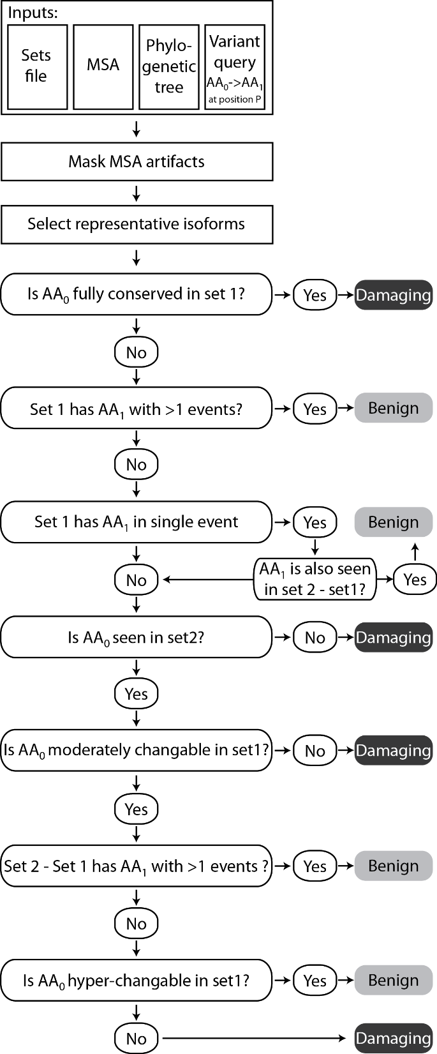
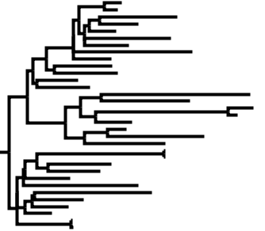
D
D
D
D
D
D
D
D
D
D
D
D
D
D
D
D
D
D
D
D
D
D
K
K
D
D
D
D
D
D
D
D
D
D
D
D
D
D
D
D
D
D
D
D
D
D
D
D
D
K
D
K
D
K
D
K
D
K
D
K
D
K
D
K
D
K
K
K
D
K
D
K
D
K
D
K
D
K
D
K
D
K
D
K
D
D
D
D
D
D
D
D
D
D
D
D
D
D
D
D
D
D
D
D
D
D
D
D
D
D
D
D
D
D
D
D
D
D
D
D
D
D
D
D
D
D
D
D
D
D
D
D

Slide 54
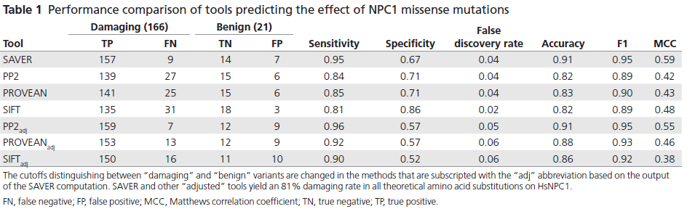

Slide 56
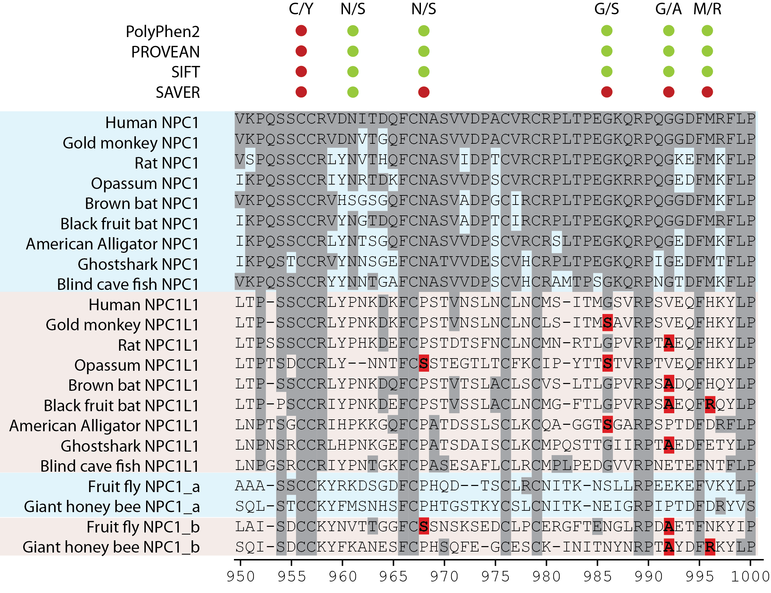

Slide 57
Conclusion
Remote homologs that are not functionally identical with the queried protein should be excluded.
Paralogs should not be included in the analysis.
Using different sets in the algorithm is helpful.
Phylogenetic analysis is a must.

Slide 58
A protein
What is its function?
Who are its partners?
What is the importance of each amino acid?
CDvist
AQUERIUM
SAVER

Slide 59

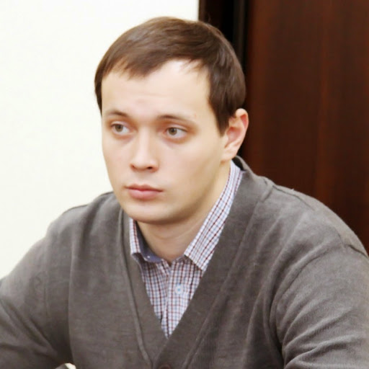
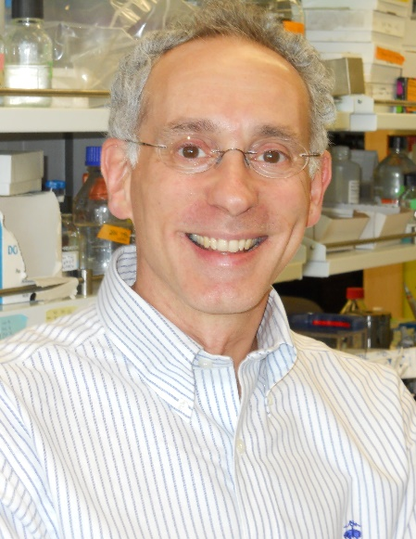




Acknowledgments
Dr. Igor Zhulin
Dr. Alexander Reznik
Dr. Daniel Ory

Slide 61
 | Damaging (166) |  | Benign (21) |  | Sensitivity (TPR) | Specificity | False Discovery Rate (FDR) | Accuracy | F1 | MCC
 | True positive | False negative | True negative | False positive
SAVER | 157 | 9 | 14 | 7 | 0.95 | 0.67 | 0.04 | 0.91 | 0.95 | 0.59
PP2 | 139 | 27 | 15 | 6 | 0.84 | 0.71 | 0.04 | 0.82 | 0.89 | 0.42
PROVEAN | 141 | 25 | 15 | 6 | 0.85 | 0.71 | 0.04 | 0.83 | 0.90 | 0.43
SIFT | 135 | 31 | 18 | 3 | 0.81 | 0.86 | 0.02 | 0.82 | 0.89 | 0.48
PP2adj | 159 | 7 | 12 | 9 | 0.96 | 0.57 | 0.05 | 0.91 | 0.95 | 0.55
PROVEANadj | 153 | 13 | 12 | 9 | 0.92 | 0.57 | 0.06 | 0.88 | 0.93 | 0.46
SIFTadj | 150 | 16 | 11 | 10 | 0.90 | 0.52 | 0.06 | 0.86 | 0.92 | 0.38

Slide 62
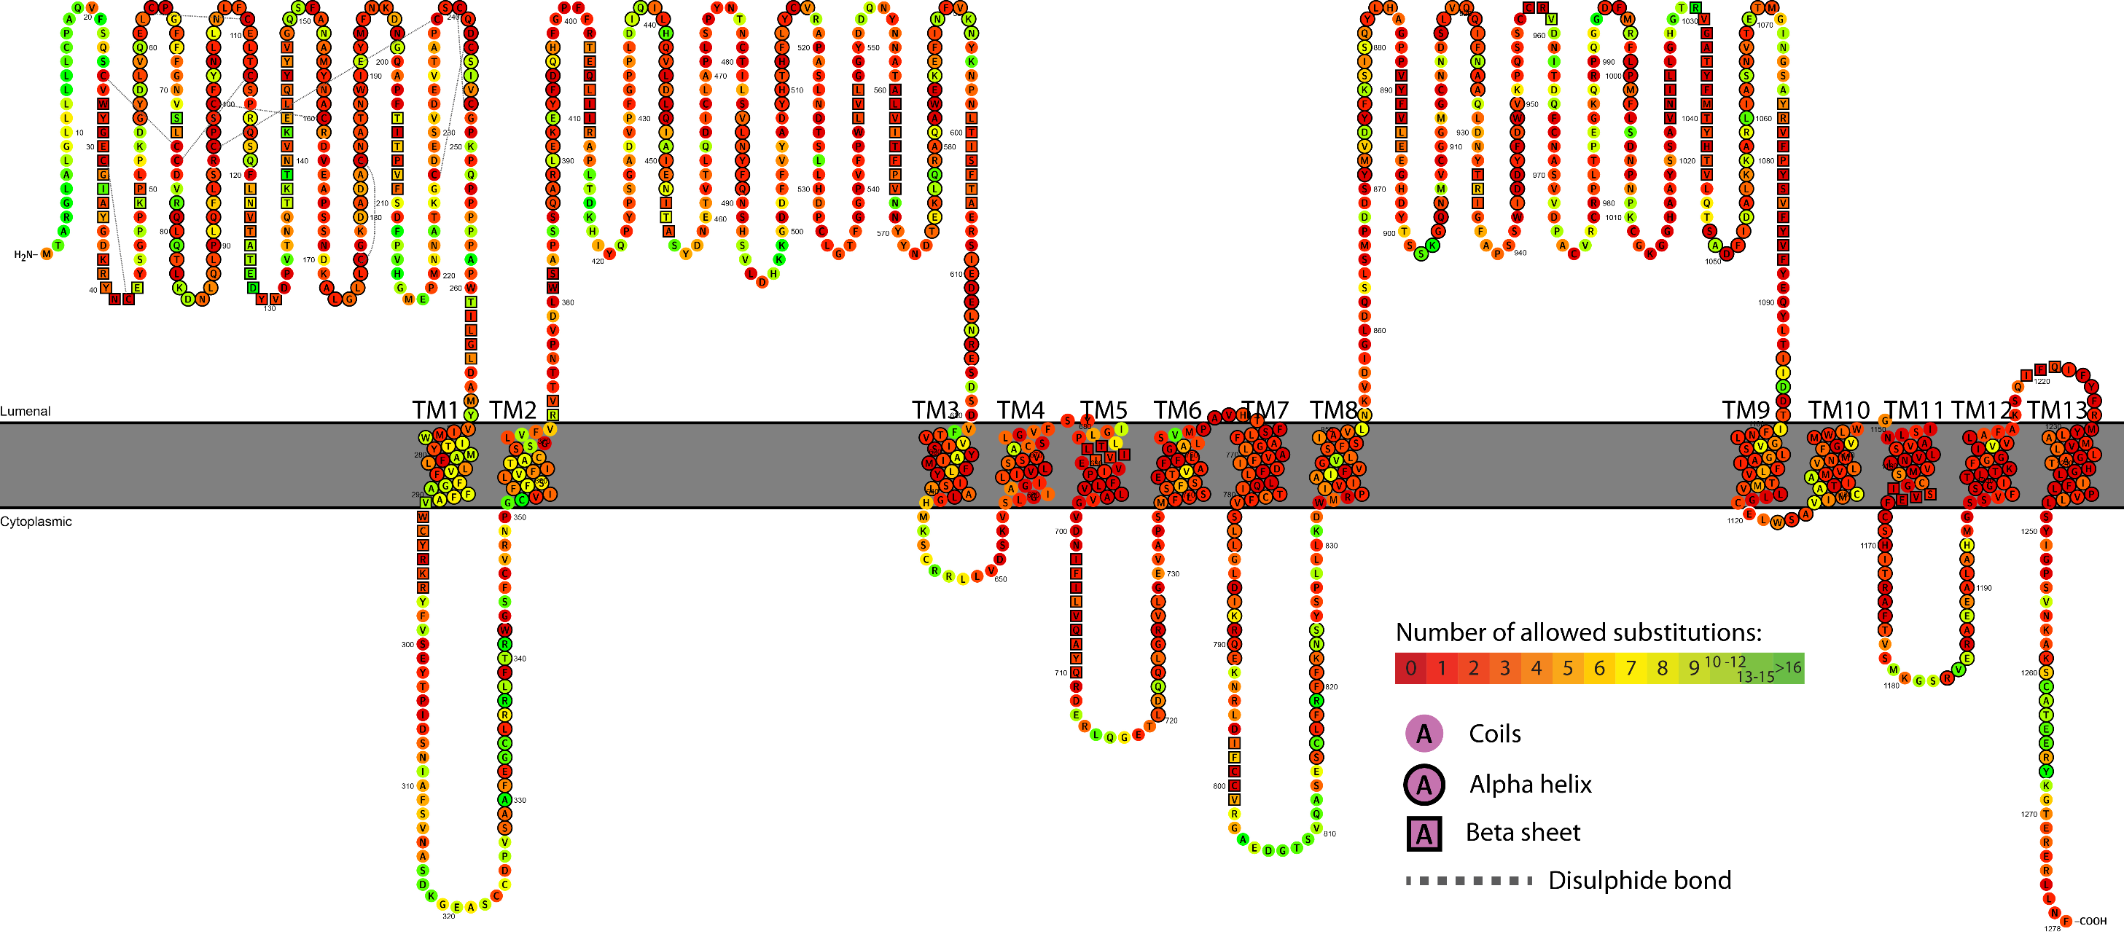
Notes:
Risk Map

Slide 63
Future aims
Phylogenetic profiling on the phylogenetic tree of life.
Building a database on co-occurrence profiles of domains.
Fully automated algorithm for predicting missense mutation effect based on functional orthologs.
Notes:
Automating orthology/paralogy distinction.
Resolving orthology sets for each human gene.
Building well-constructed MSA with functional orthologs of each human gene.
Machine learning application and optimization on SAVER algorithm.

